Slide 1
TRAIN COLLISION DETECTOR

Slide 2
1.Designers : A. Indu Sree -22H51A0402
G. Chaitanya -22H51A0422
K. Lasya Priya -22H51A0432
Md. Faisal -22H51A0442
M. Manohar -22H51A0441
2.Clients : CMR College are engineering and technology
3.Users : Government (Indian railways)

Slide 3
Statement:
“Design a device which senses an obstacle and brakes are applied in the train which is made by using Arduino, ultrasonic sensor and motor, cost around Rs.2500/-, works on the base of sensing technology”.

Slide 4
INTRODUCTION:
Train collision detectors are advanced safety devices designed to prevent train collisions and improve railway safety.
These detectors utilize a combination of sensors, algorithms, and communication systems to monitor and control centers about potential collisions.
Train collision detectors play a crucial role in enhancing the overall efficiency and safety of railway operations.

Slide 5
ABSTRACT
The number of collisions occurred in railways. Because collisions were occurred due to track cracking and not identified the trains coming on the same track at the right time. Maximum peoples were losing their lives due to collision. Most of the accidents were occurred with negligence of humans and without proper communication from Train Traffic Control Station (TTCS).to prevent this problem we identified a sensors which will identify the railway track cracks and identify the opposite train in the same track within a short time. The purpose of the project is to develop and design a low-cost system with high integrity and reliability for enhancing to prevent the train’s collisions by Train Collision Detector. In this ,we used UV sensors, IR sensors, LPC2148 processor to prevent train collision as well as track cracks. In this paper we give the solution on how to put on automatic brakes when a animal or human get on the track.

Slide 6
EXISTING SOLUTIONS :
The Automatic Train Protection (APT) system is an integral part of railway safety, responsible for monitoring and controlling train movements to ensure safe operations. It incorporates a network of sensors placed along the tracks to detect various parameters, such as train speed, location, and track conditions.The APT system continuously collects and analyzes data from the sensors in real-time. It compares the measured values against predefined safety thresholds and operating limits. If any deviation or potential hazard is detected, the APT system triggers appropriate actions to prevent accidents or collisions.Through its centralized control system, the APT system communicates with the trains, signaling equipment, and dispatch centers. It provides essential information and commands to train operators, enabling them to adjust their speed, apply emergency braking, or take other necessary actions to maintain safety.The APT system relies on advanced communication technologies to ensure timely and accurate data transmission between the various components. It integrates with train signaling systems, such as automatic block signaling or cab signaling, to enhance the overall safety and efficiency of train operations.The implementation of an APT system brings significant benefits to railway networks, including improved safety, reduced risk of accidents, and enhanced operational performance. By continuously monitoring train movements and implementing proactive safety measures, the APT system plays a crucial role in preventing collisions, derailments, and other potentially hazardous incidents.

Slide 7
Proposed Solution :
Designing a device which senses an obstacle and brakes are applied in the train which is made by using Arduino, ultrasonic sensor and motor. the role of the ultrasonic sensor is, detects the obstacles and range of the ultrasonic sensor is 300m, the device should cost around Rs.2500/-, works on the base of sensing technology called Train Collision Detector.

Slide 8
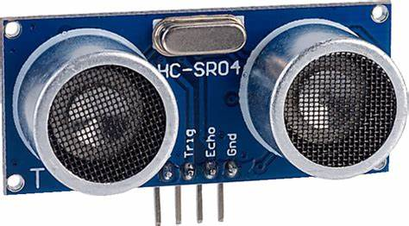
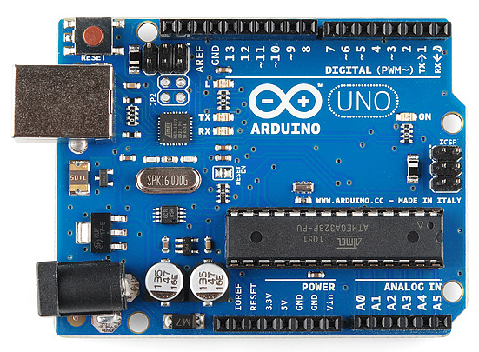
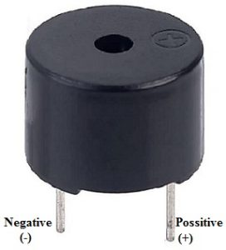
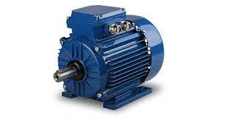
Components :
ULTRSONIC SENSOR
BUZZER
ARDUINO
MOTORS

Slide 9
Working of Train Collision Detector:
Train collision detectors use various sensors, such as
Ultrasonic sensor to detect obstacles or other trains along
the track . The collected sensor data is analyzed in real-time
using sophisticated algorithms to identify potential collision risks.
If a collision risk is detected by a sensor , the detector sends alerts to the train operator and the brakes are applied .

Slide 10
BLOCK DIAGRAM:
MOTOR
SENSOR
POWER SUPPLY
AURDINO
BUZER

Slide 11
It costs around Rs.2500.
Budget :

Slide 12
ADVANTAGES:
-Enhanced Safety: Train collision detectors significantly reduce the
risk of accidents and collisions, ensuring the safety of passengers,
crew, and infrastructure.
-Improved Efficiency: By detecting potential collision risks in advance, these detectors optimize train schedules, minimize delays, and
improve overall operational efficiency.
-Cost Savings: Avoiding train collisions helps prevent costly damages
to trains, tracks, and surrounding infrastructure, resulting in
substantial cost savings.

Slide 13
CONCLUSION:
Train collision detectors are vital safety devices that help prevent
train collisions and improve railway safety.
With their advanced sensor technologies, algorithms, and communication systems, these detectors significantly enhance the efficiency and reliability of train operations.
Continuous advancements and widespread adoption of train collision detectors will continue to drive the improvement of railway safety and efficiency.

Slide 14
References:
http://www.apt.int/sites/default/files
http://www.indiatimes.com/amp/explainers/news/indian-railways-indigenous-anti-collision

Slide 15
THANK YOU

